Slide 1

DENGUE ANALYSIS
SUBMITTED BY:-
ASHWANI PANDEY-12211155
ABHISHEK KUMAR-12213098
Submitted To:
Amninder Kaur

Slide 2

Why this project ?
Need for such survey
Public health Impact
Data availability
Interdisciplinary approaches

Slide 3

INTRODUCTION
Dengue fever, a mosquito-borne viral infection
The World Health Organization estimates that around 390 million dengue infections occur globally each year, of which approximately 96 million manifest clinically.
This study investigates dengue prevalence in LPU hostel and village near LPU. We analyze a dataset from google form containing numeric and character data points with features like [name, age, suffered or not, duration, RBC/WBC level, hemoglobin level, platelets count and PCV count]. We employ machine learning algorithms including Logistic Regression to classify dengue cases. We evaluate the models using metrics like accuracy, precision, recall, and F1-score.

Slide 4

DATA COLLECTION PROCESS
Our beautiful Form
https://forms.office.com/r/G3UT5FGR5X
3. We faced less challenges as compared to other collectors. Because we heavily invested our time in form creation, though can’t ignore the financial ones

Slide 5
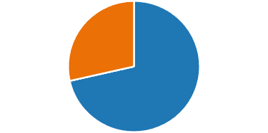
Gender Participation
Gender participation in data collection
Male-238
Female-95
Female-29%
Male-71%

Slide 6
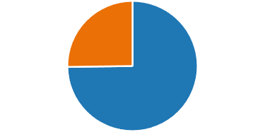
SUFFERING FROM DENGUE
How many people were suffered from dengue ?
Conclusion:
75% male and 25% female suffered from dengue.
NO-75%
YES-75%
6

Slide 7
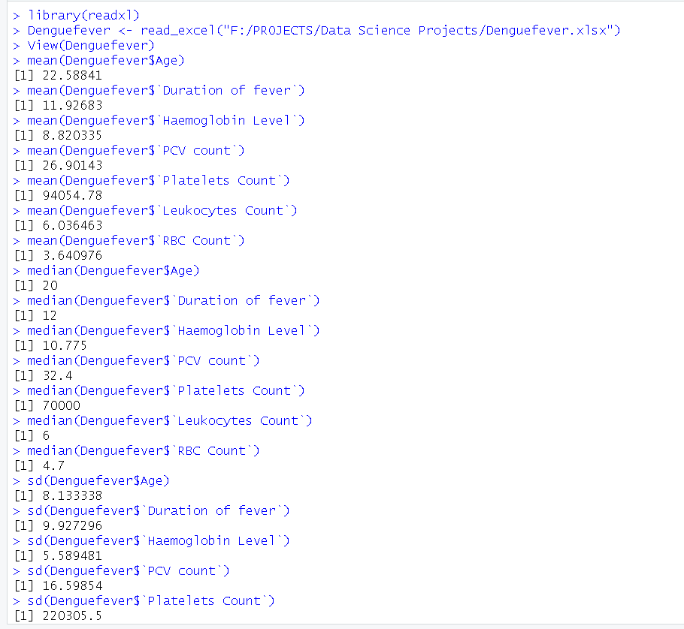
DESCRIPTIVE STATISTICS
We find:
Mean
Median
Mode
Standard Deviation

Slide 8
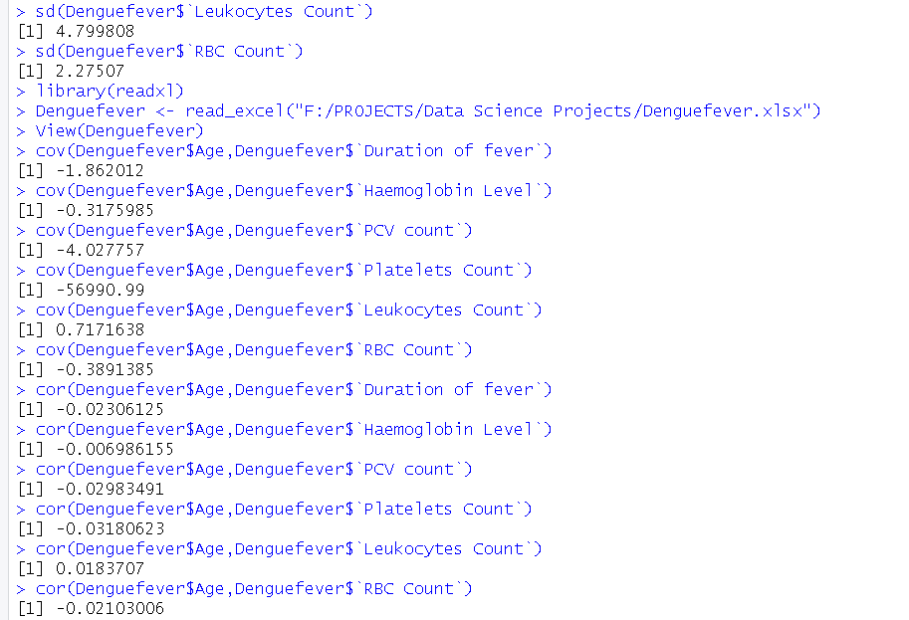
DESCRIPTIVE STATISTICS
We find:
Co-variance
Cor-relation

Slide 9
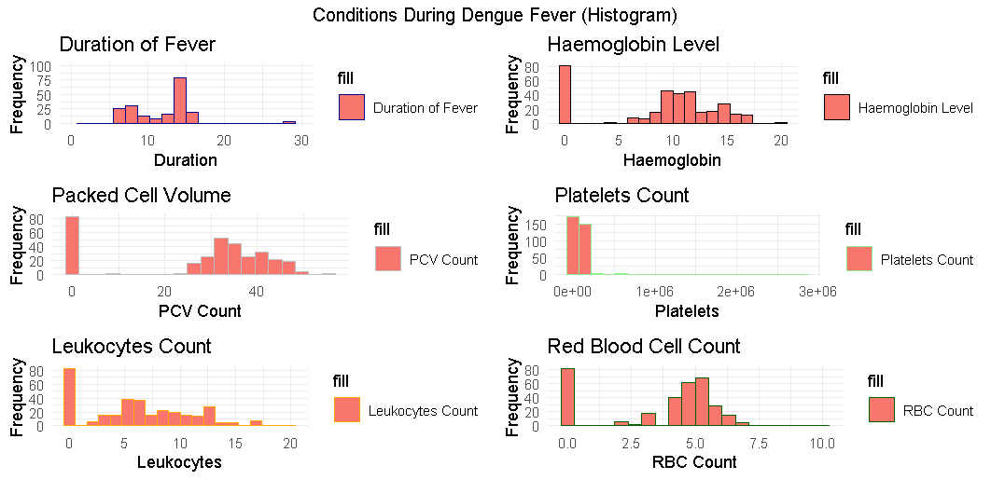
VISUALIZATION IN HISTOGRAMS
A histogram is a graphical representation of the distribution of numerical data. It consists of a series of adjacent rectangles, or bins, where the width of each bin represents a range of values, and the height of each bin represents the frequency or count of data points within that range.

Slide 10
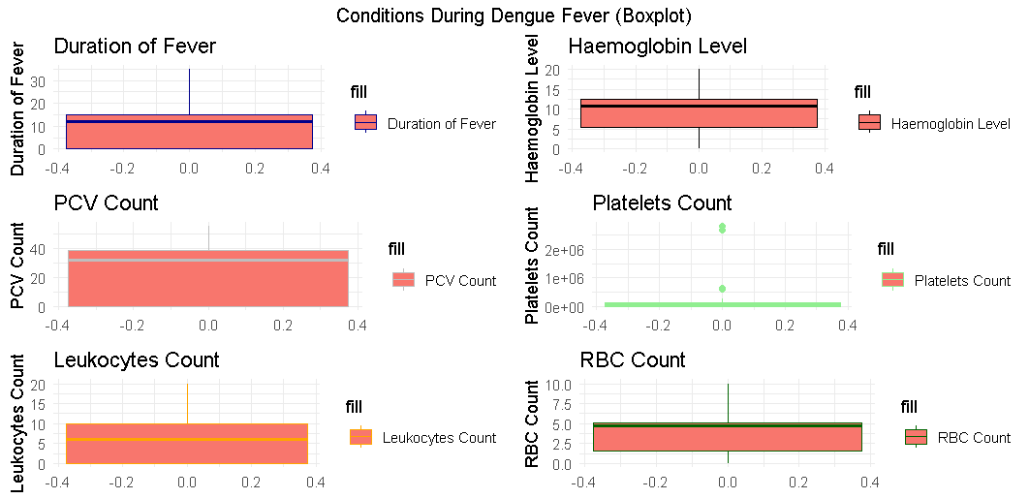
VISUALIZATION IN BOXPLOT
In R, a boxplot is a graphical representation of the distribution of numerical data through their quartiles, as described earlier. The boxplot() function in R is used to create boxplots, and it accepts one or more numerical vectors as input.

Slide 11
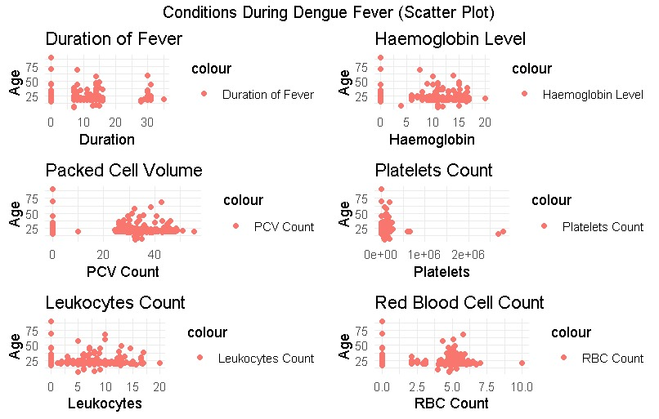
VISUALIZATION IN SCATTERPLOT
A scatterplot is a type of graphical representation used to display the relationship between two continuous variables. It consists of a plot where each data point is represented by a dot or marker, positioned according to its values on the two variables being compared.

Slide 12
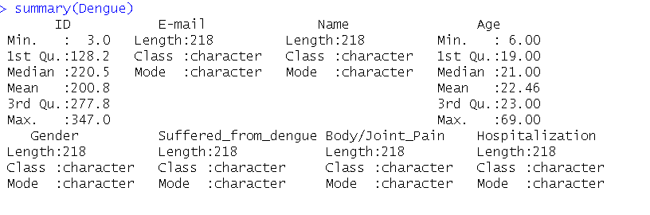
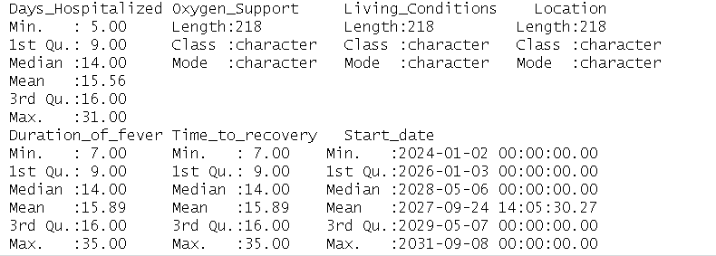
SUMMARY OF DATASET

Slide 13
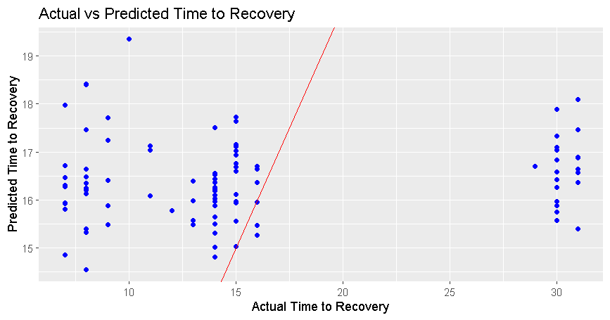
LINEAR REGRESSION MODEL

Slide 14
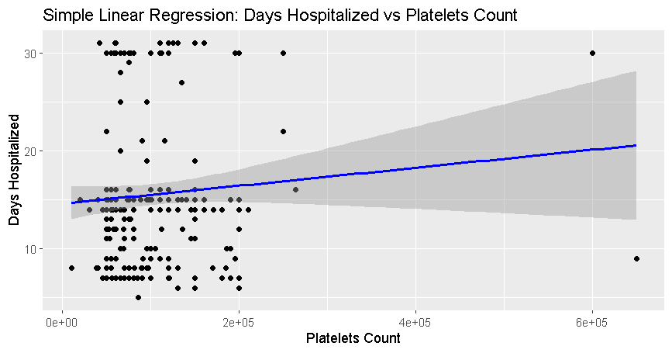
SIMPLE LINEAR REGRESSION MODEL

Slide 15
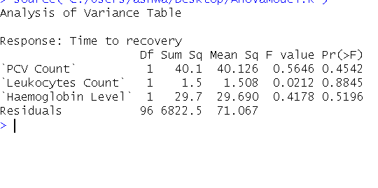
ANOVA (ANALYSIS OF VARIANCE)

Slide 16

Large Image slide
CONCLUSION
The conclusion for the presentation would be a summary of the key findings and insights from data collection and analysis process which involves visualization of gender participation, number of people suffered, age of people suffered from dengue and the distribution of disease in LPU Hostel and nearby village. At last it emphasizes the significance of the study in identifying high-risk populations, informing, targeted prevention and control strategies, and the overall public health impact of the research.

Slide 17


Thank You
Ashwani Pandey
ashwanipandey4545@gmail.com

